Slide 1
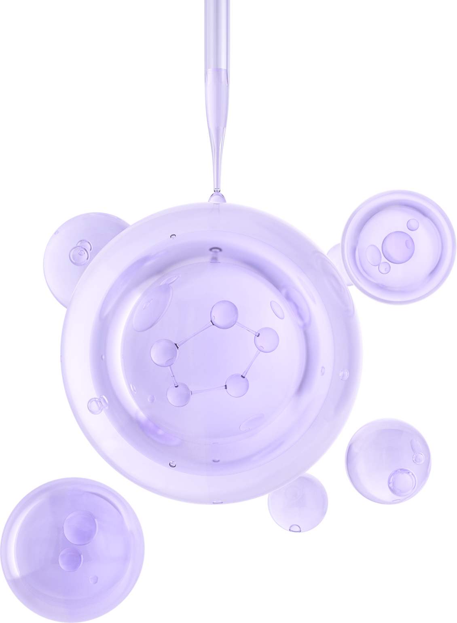

UNIVERSITY OF BASRAH / COLLEGE OF SCIENCE
LECTURE PhD. 3
Prokaryotic Cell wall
Department of Biology
Prof.Dr. Saad S. Mahdi Al-Amara

Slide 2
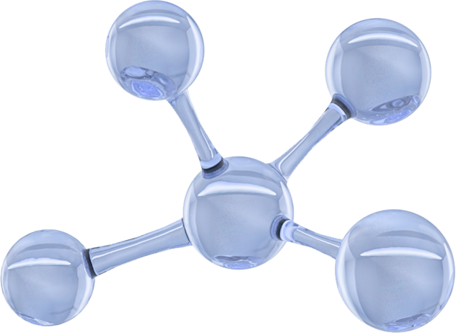
The proposed pathway for the synthesis of LTA occurs in three phases:
(1) The glycolipid anchor.
(2) The poly(glycerophosphate) component .
(3) The D-alanyl esters linked to poly(glycerophosphate).
Membrane LTAs of the glycerophosphate polymer type occur in many gram-positive bacteria.
These compounds have long polar glycerolphosphate chains linked to a small hydrophobic glycolipid.
The LTA of S. pyogenes is a polymer-containing glycerophosphate linked to a glycerophosphoryl diglycosyl diglyceride. In E. hirae the glycolipid is phosphatidylkojibiosyl diglyceride.

Slide 3
Release of TA and LTA may influence the
1.Interaction of bacterial pathogens with cells of the invaded host .
2.Serological reactivity, Tas .
3.May activate the alternative pathway of complement .
4. May play a role in the specific adhesion of bacteria to host epithelial surfaces.
A number of Gram-positive bacteria are known to lack classical LTAs. In their place, polymers with chemical properties similar to those of LTAs have been identified.
These polymers are variously referred to as macroamphiphiles, lipoglycans, or cell surface glycolipids .

Slide 4
Outer Membranes of Gram-Negative Bacteria
Gram-negative bacteria display a prominent outer membrane that is peripheral to the periplasmic region and the peptidoglycan sacculus (Fig. 1-2).
his outer membrane is covalently attached to the peptidoglycan layer through lipoprotein and serves to reinforce the shape of the cell and to provide a protective barrier against the external environment.
Chemical analysis shows that they are similar in lipid content.
Some components of the outer membrane are qualitatively similar to those of the cytoplasmic membrane.
however, the outer membrane appears as an asymmetric bilayer, with the external layer being composed primarily of LPS.
Outer membrane proteins (OMPs), called porins, form large water-filled pores with diameters of 1 to 2 mm that traverse the membrane and regulate the access of hydrophilic solutes to the cytoplasmic membrane.

Slide 5
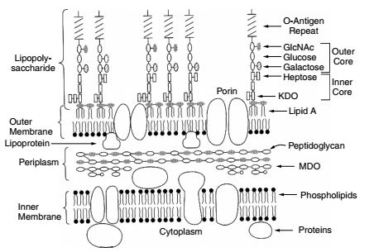
Fig. 1-2. Diagram of gram-negative bacterial cell surface.

Slide 6
Lipopolysaccharides.
Lipopolysaccharides consist of three basic components or regions, as shown in Figures 1-2 .
RegionI,
the outermost portion, contains repeating carbohydrate units that represent the “O” antigen. Alteration in the sugar composition of the O antigen results in a change in the immunological specificity.
The sugars found in the O-antigen region can occur in a wide variety of combinations, accounting for tremendous antigenic diversity and many hundreds of chemical types or serotypes of Salmonella, Shigella, and other Enterobacteriaceae.

Slide 7
core region (region II)
consists of an outer and an inner core.
The outer core : shows high-to-moderate structural variability.
The inner core : shows very low structural variability, particularly within a very closely related group of organisms, for example, the Salmonella.
The oligosaccharide subunits of the core region of E. coli and Shigella differ only slightly from those of Salmonella.
In other Gram-negative bacteria less closely related to the enteric bacteria, a greater diversity in the structure of the core region may be encountered.
However, the unique octose sugar, 2-keto-3-deoxyoctulosonic acid (KDO), appears to be a common component of the core region
of most gram-negative organisms.

Slide 8
Lipid A (region III)
Embedded in the outer membrane, has been extensively studied
in Salmonella.
In this organism, the chemical composition of lipid A has been shown to consist of a chain of D-glucosamine disaccharide units with all of the hydroxyl groups substituted.
The substituents are the core polysaccharide units on the one hand
and long-chain fatty acids on the other.
The most commonly observed fatty acid is β-hydroxymyristic acid (3-hydroxy-tetradecanoic acid), a C14 saturated fatty acid that is substituted on the amino groups.

Slide 9
Porins.
A variety of other OMPs are found in the Enterobacteriaceae and other gramnegative bacteria.
As shown in (Table 1-1) , these OMPs play a variety of overlapping
roles in the physiology of the cell.
Some of these proteins facilitate the entry of specific metabolites such as vitamin B12, iron, or maltose .
while others, such as OmpC and OmpF, constitute components of general porins that allow hydrophilic solutes of a molecular weight less than 700 to traverse the outer membrane.
Both OmpF and OmpC have similar functional and structural properties, but expression of their structural genes.
ompF and ompC, is regulated in opposite directions by the osmolarity of the growth medium .

Slide 10
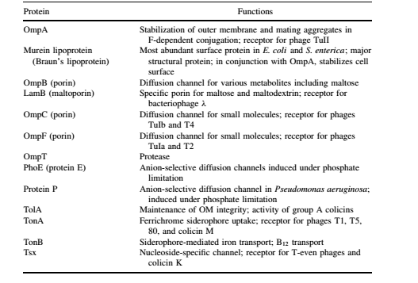
TABLE 1-1. Outer Membrane Proteins of Gram-Negative Bacteria

Slide 11
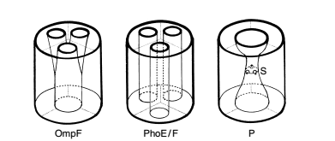
Fig. 1-3. Schematic three-dimensional representations of the structures of three different porin proteins.

Slide 12
Murein lipoprotein
is a major OMP present in large quantities in E. coli.
Lipoprotein molecules serve to anchor the outer membrane to the peptidoglycan layer.
Mutants lacking lpp, the structural gene for lipoprotein, and ompA, the structural gene for OmpA, display spherical morphology and abundant blebbing of the outer membrane.
In these mutants the murein layer is no longer associated with the outer
membrane.
These mutants also display an increased growth requirement for Mg2+ andCa2+ and are sensitive to hydrophobic antibiotics such as novobiocin, or to detergents, suggesting a protective function of the outer membrane.

Slide 13
Lipopolysaccharide Biosynthesis
The three components of LPS (O-antigen, core oligosaccharide, and lipid A) are synthesized independently of each other and later ligated in or on the inner membrane.
After assembly, LPS structures defined in terms of polysaccharide composition as shown in Figure 1-7.
Most of the genetic determinants responsible for oligosaccharide core biosynthesis in E. coli and S. enterica have been shown to reside in the rfa gene cluster.
The genes coding for the five transferases (rfaKJIGB) required for assembly of the outer core region of E. coli LPS have been identified as shown in Figure 1-3.

Slide 14
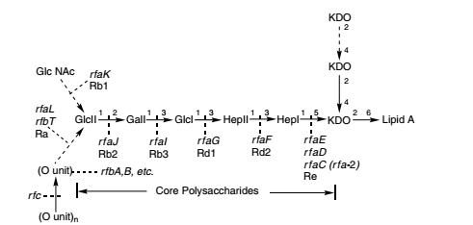
Fig. 1-3. Schematic representation of the genetic determinants of the LPS of S. enterica serovar Typhimurium.

Slide 15
The rfaD gene codes for ADP-L-glycero-D-mannoheptose-6-epimerase.
Mutation in the rfaC gene results in production of a heptoseless LPS structure referred to as chemotype.
These mutants display increased permeability to both hydrophobic and hydrophilic agents.
In S. enterica, the rfaL gene encodes a component of the O-antigen ligase and rfaK encodes the N-acetylglucosamine transferase.
The major pathway leading to lipid A biosynthesis takes place in three stages:
stage 1, UDP-GlcNAc acylation .
stage 2, disaccharide formation and 4 kinase action .
stage 3, KDO transfer and late acylation.

Slide 16
THANK YOU

